Slide 1
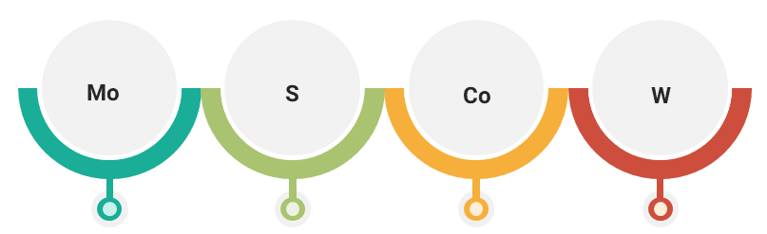
Must
Should
Could
Won’t

